Slide 1
VAXTRACK v2.0.0
Platform Overview
From demo to deployable: a ground-up rebuild for real hospitals, real scale, and full accountability.
ASP.NET Core (.NET 10)
Angular 20
SQL Server
JWT Auth
Vivek Kumar | Senior Associate Consultant, Infosys — Developer, British Petroleum

Slide 2
AGENDA
1
Executive Summary
6
How It Works, End to End
2
Why We Rebuilt
7
Business Rules & Guardrails
3
What's New vs. V1
8
Technology Snapshot
4
Core Features
9
Documentation & Governance
5
Roles & Access Model
10
What's Next
VaxTrack v2.0.0 — Platform Overview

Slide 3
EXECUTIVE SUMMARY
VaxTrack is a two-dose vaccination management platform. It tracks a beneficiary's vaccination journey end to end — registration, hospital discovery, dose booking and approval, and a verifiable completion certificate — while giving each hospital self-service control over its own slot capacity, and giving a platform operator full oversight of hospitals and users, with a complete audit trail on every action.
3
user roles, fully scoped
6
API modules
This is the current, actively developed version of VaxTrack — replacing the single-developer v1.x demo line entirely.
100%
actions carry an audit trail
VaxTrack v2.0.0 — Platform Overview

Slide 4
WHY WE REBUILT
Vaccination programs that span many independently-operated hospitals run into three recurring problems: beneficiaries have no single place to book and track a two-dose course; hospitals have no shared, live view of their own slot capacity or who is due to arrive; and program administrators have no consolidated way to oversee hospitals and enforce accountability — who approved what, who disabled which account, and why.
What v2.0.0 commits to
•
One place for every beneficiary to register, discover hospitals, book both doses, and produce a verifiable certificate.
•
Self-service slot and contact-detail control for every hospital — no platform-admin involvement for routine changes.
•
Full platform-operator oversight — disable, reactivate, or unregister any hospital or user, with a mandatory reason and a full audit trail.
•
Every state-changing action accountable: who did it, to what, when, and why.
VaxTrack v2.0.0 — Platform Overview

Slide 5
WHAT'S NEW VS. V1
Not an iteration — a different platform, built for a different scale of problem.
Dimension | V1 (Beta → v1.3.0) | V2.0.0
Scope | Single hospital, demo-scoped | Multi-hospital directory, production-oriented
Roles | 2 roles (User, Admin) | 3-tier model — User, Hospital Admin, Platform Admin
Accountability | No formal audit trail | Every state change logged: actor, action, reason
Records | Status flag only | Downloadable, publicly verifiable certificates
Stack | ASP.NET MVC, SQLite, Razor | ASP.NET Core Web API, SQL Server, Angular SPA
Feedback | alert() / toast messages | In-app notification system, fired on every event
VaxTrack v2.0.0 — Platform Overview

Slide 6
CORE FEATURES
Seven capabilities, each enforced server-side — not just hidden in the UI.
1
Two-Dose Booking Lifecycle
2
Three-Tier Role Model
3
Hospital & User Lifecycle Mgmt
Book, approve, reject, cancel, edit, and rebook a dose — slot capacity reserved and released automatically.
Normal user, hospital admin (scoped to one hospital), and platform admin — enforced on every request.
Disable, reactivate, and (for hospitals) a two-party unregister/authorize flow, with mandatory reasons.
4
Self-Service Flows
5
In-App Notifications
6
Vaccination Certificates
Forgot/reset password, reactivation requests, and hospital-admin applications — each with an approval queue.
Fired on every approval, rejection, and status change.
Downloadable and publicly verifiable via a bookingId link, without exposing personal contact details.
7
Full Audit Trails
Every state-changing action on a booking, hospital, or user is permanently logged with actor, action, and reason.
VaxTrack v2.0.0 — Platform Overview

Slide 7
ROLES & ACCESS MODEL
Every rule is enforced server-side — identical whether the request comes from the Angular app or a raw API call.
Normal User
Hospital Admin
Platform Admin
Full control over their own profile and booking. No visibility into other users' data.
A normal user additionally scoped to exactly one hospital — manages that hospital's contact info, slot capacity, and dose approvals only.
Unconditional access across every module — user/hospital lifecycle, all bookings, role assignments, and pending-request queues.

Slide 8
HOW IT WORKS, END TO END
The full lifecycle the platform supports — tied together by notifications firing on every status change.
1
2
3
4
5
Register & Discover
Book Dose 1
Hospital Approves
Book Dose 2
Certificate
→
→
→
→
Beneficiary registers, browses the hospital directory.
Selects a hospital and slot; capacity is reserved automatically.
Hospital admin reviews and approves within their own scope.
Same flow repeats for the second dose once Dose 1 is complete.
Verifiable completion certificate generated — public, link-based.
Running alongside every step: hospital-admin oversight of their own bookings, and platform-admin oversight across all hospitals and users.
VaxTrack v2.0.0 — Platform Overview

Slide 9
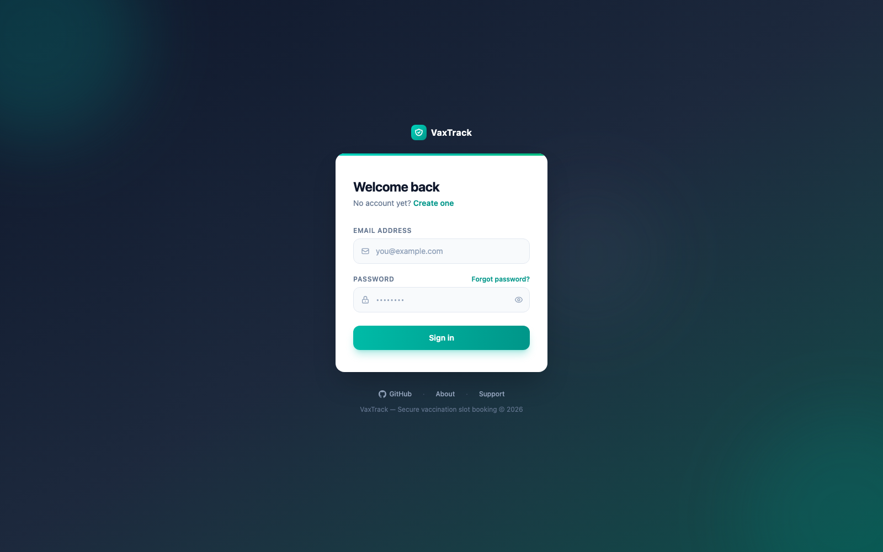
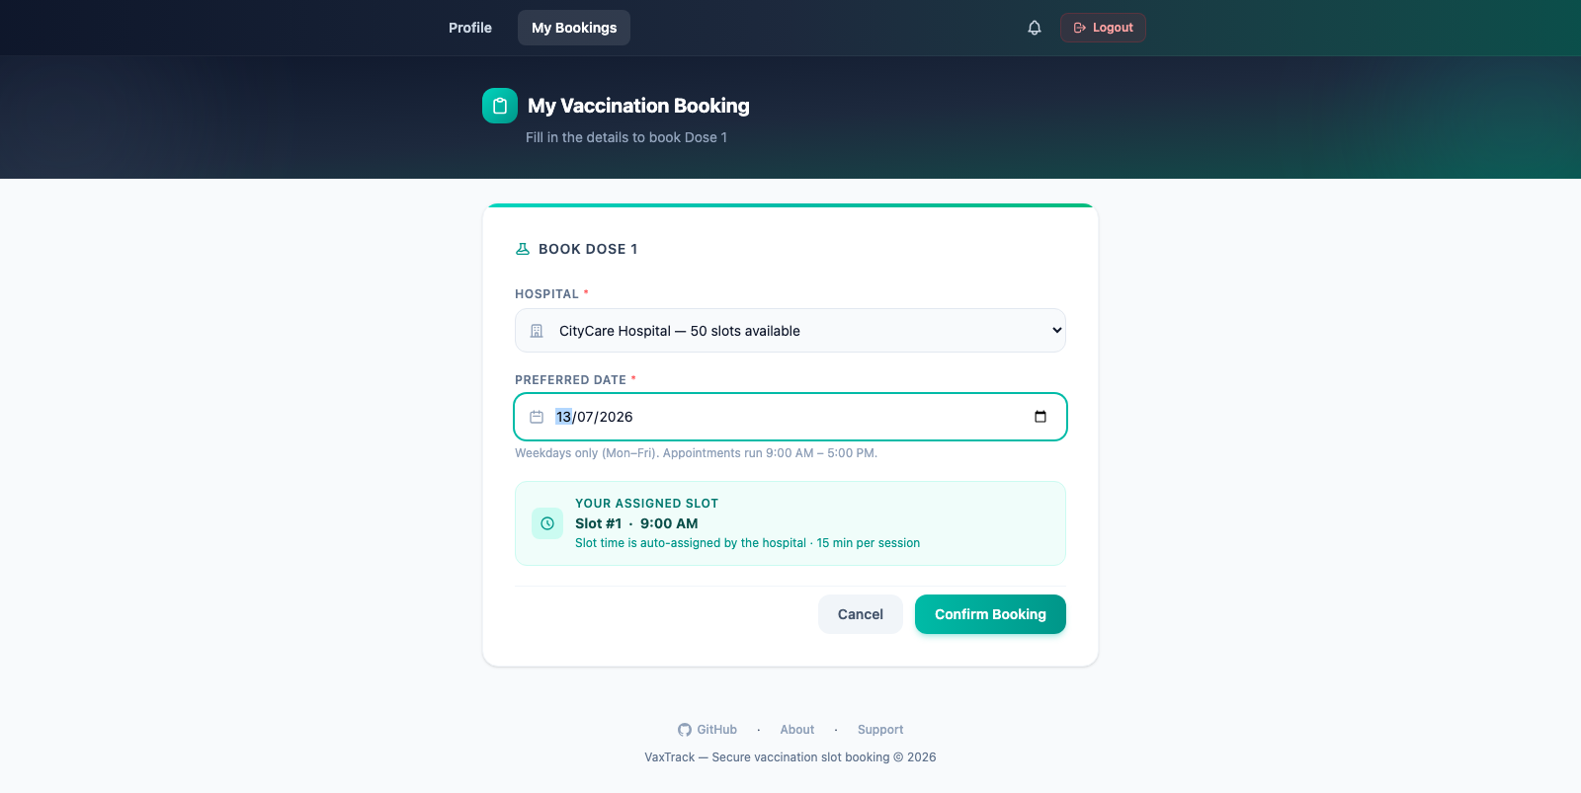
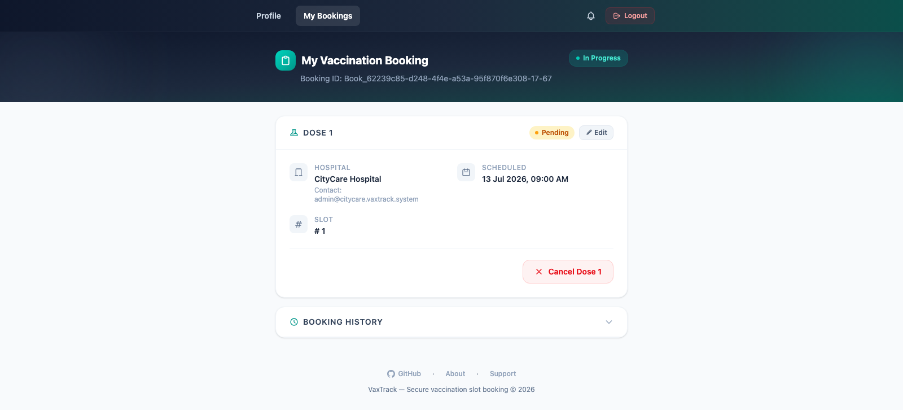
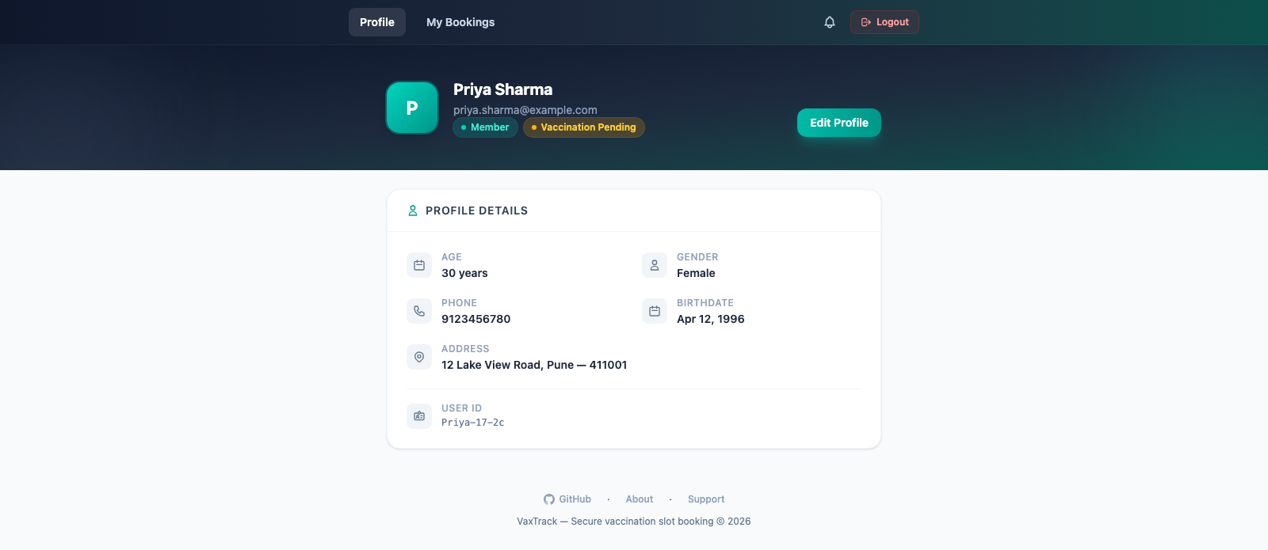
PLATFORM IN ACTION — BENEFICIARY JOURNEY
Live v2.0.0 screens, from sign-in to a booking in progress.
Sign in
Book Dose 1 — hospital & slot selection
My Bookings — Dose 1 pending approval
User Profile
VaxTrack v2.0.0 — Platform Overview

Slide 10
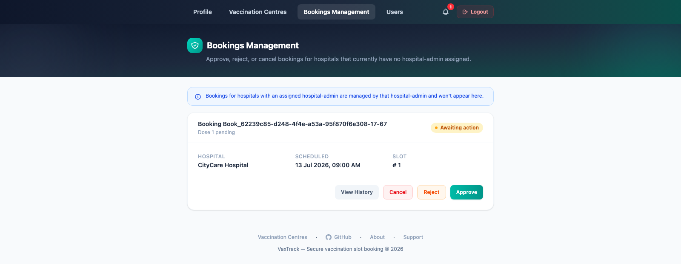
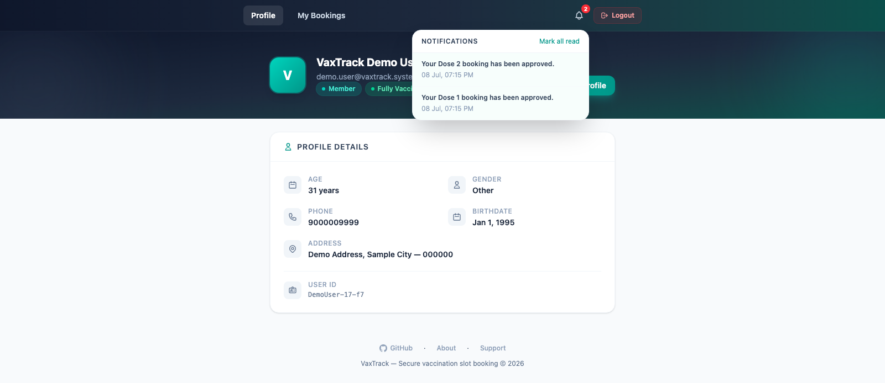
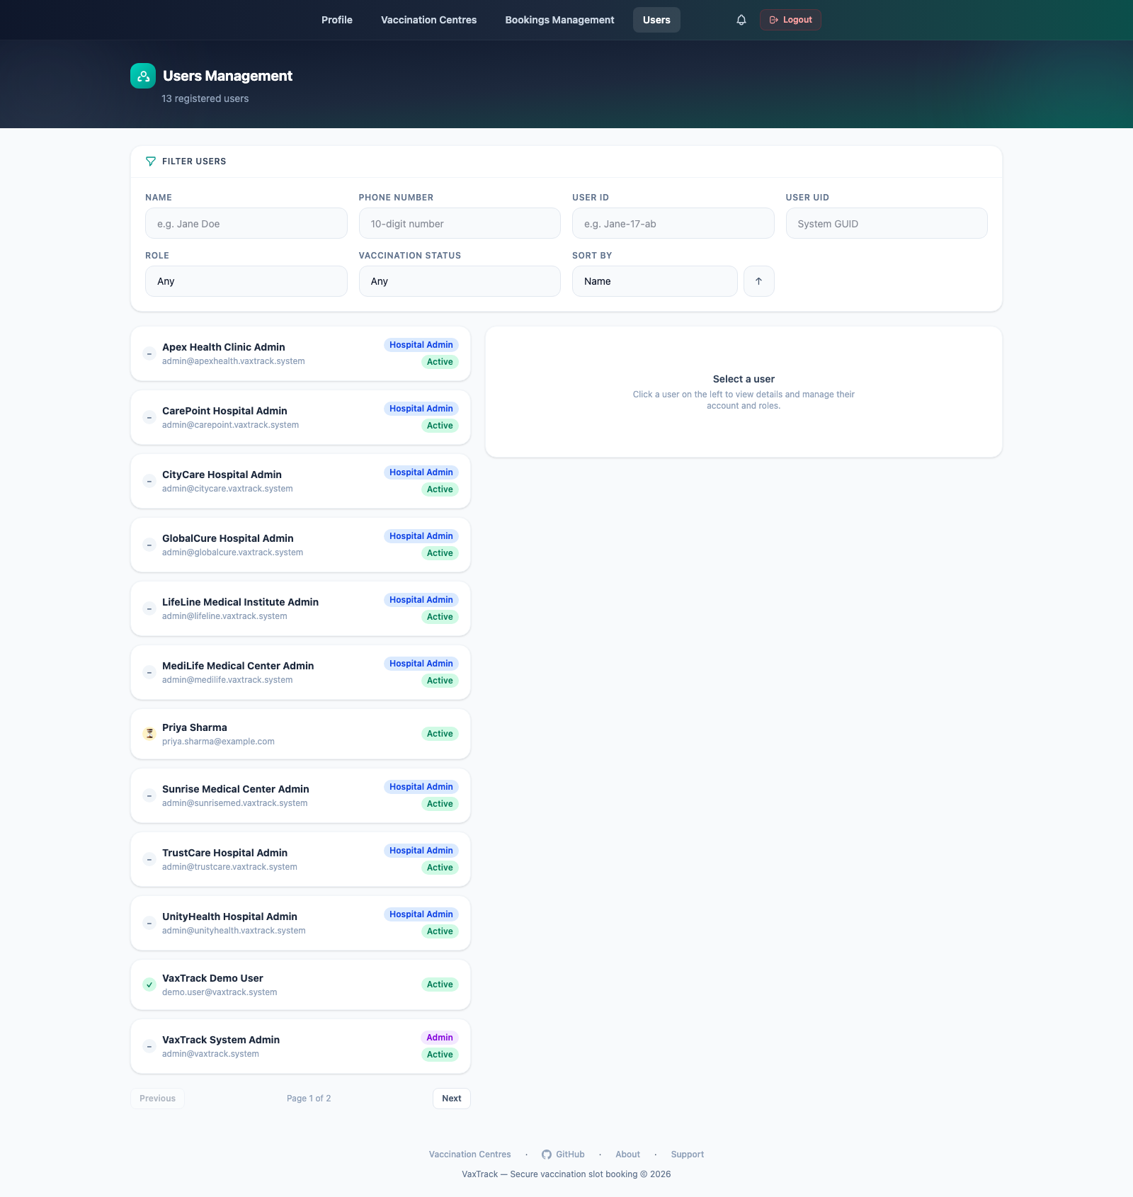
PLATFORM IN ACTION — HOSPITAL & PLATFORM OVERSIGHT
Admin-side screens — approvals, user management, and in-app notifications.
Bookings Management — platform-admin approval queue
In-app notifications
Users Management — platform-wide directory
Platform Admin Dashboard
!
In development
Platform-wide stats overview — not yet implemented as of this build.
VaxTrack v2.0.0 — Platform Overview

Slide 11
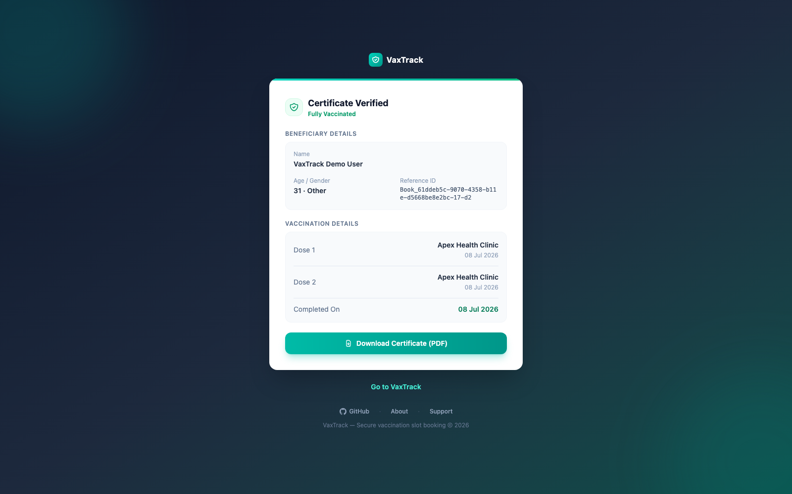
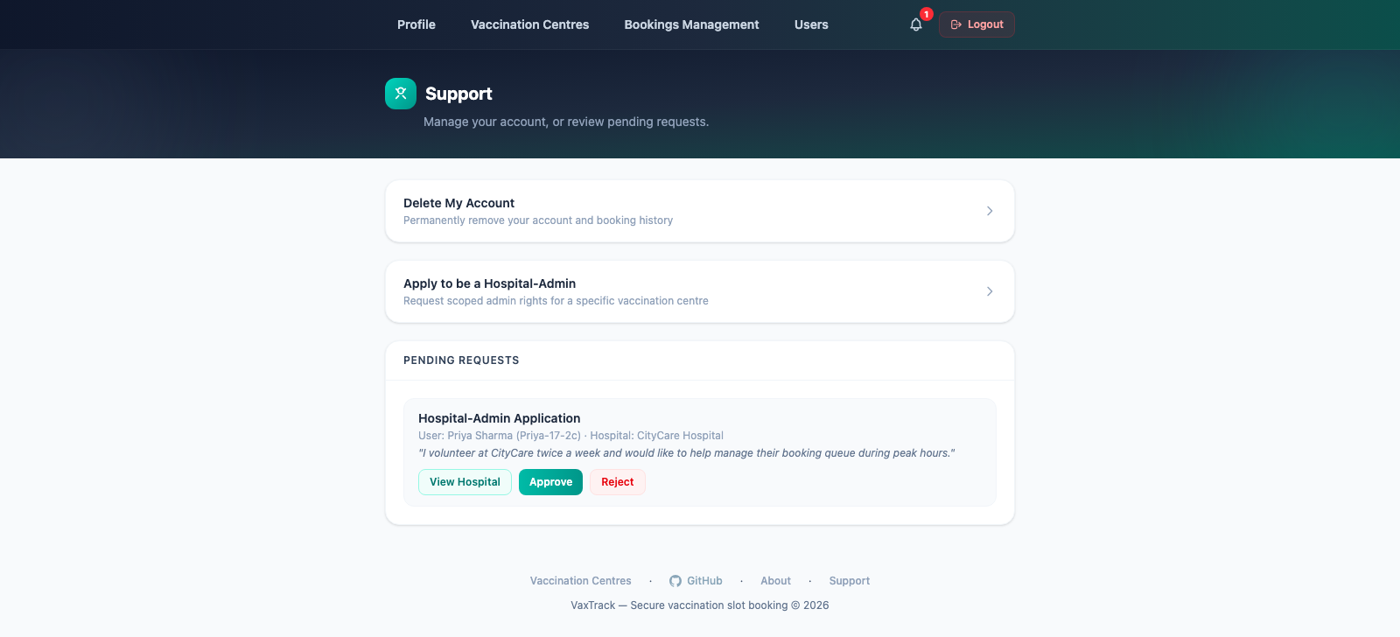
PLATFORM IN ACTION — CERTIFICATES & SELF-SERVICE
The loop closes here — a verifiable record, and a self-service path when something needs a human.
Public certificate verification (bookingId link)
Support — self-service + hospital-admin application queue
VaxTrack v2.0.0 — Platform Overview

Slide 12
BUSINESS RULES & GUARDRAILS
A sample of the rules that keep capacity and identity from being abused.
No double-booking, no booking on someone else's behalf
No login for a disabled account, under any circumstance
Every booking is tied to the authenticated caller's own identity.
Reactivation requires an explicit platform-admin approval.
No hospital removed without a second-party confirmation
A hospital's slots can never go negative or over capacity
A two-party unregister/authorize flow protects against unilateral removal.
Enforced under any sequence of concurrent booking operations.
Every disable, reactivation, unregister, and role change is traceable
No record is ever physically deleted
Actor, timestamp, and — where applicable — a reason. No gaps.
A uniform soft-delete pattern applies across users, hospitals, bookings, and credentials.
VaxTrack v2.0.0 — Platform Overview

Slide 13
TECHNOLOGY SNAPSHOT
For orientation only — full architecture depth lives in the companion Technical Specification.
Angular 20 SPA
Key choices
standalone components + TailwindCSS
Backend
ASP.NET Core Web API (.NET 10), C# 13 — API-first, no server-rendered views.
↓ REST / JSON over HTTPS
Data Access
Controllers
Entity Framework Core 10 over Microsoft SQL Server.
HTTP routing + JWT auth enforcement
Authentication
Services
Business rules, ownership & role checks
JWT Bearer (HMAC-SHA256) with server-side revocation, plus BCrypt.Net-Next for password hashing.
Repositories (EF Core)
Logging
Data access over SQL Server
Serilog, console + rolling file sinks.
SQL Server
Why API-first + SPA
Decouples the client from the server entirely — any future client (mobile, third-party) can consume the same, fully server-enforced API.

Slide 14
DOCUMENTATION & GOVERNANCE
This overview is backed by four full deliverables for teams that need the depth.
Functional Specification
Technical Specification
What the app does — business requirements, roles, workflows, permission matrix.
How it's built — architecture, HLD/LLD, every module's frontend + backend detail.
AUDIENCE: Business stakeholders, all developers
AUDIENCE: Developers, QA, tech leads
Test Case Sheet
Project Development Review
QA test cases across every module and feature.
Structured Q&A covering every part of the build, for design review.
AUDIENCE: QA, developers, tech/team leads
AUDIENCE: Tech leads, delivery managers, senior devs
VaxTrack v2.0.0 — Platform Overview

Slide 15
WHAT'S NEXT
Explicitly out of scope for this release — candidates for a future one, not gaps in today's requirements.
→
Outbound email/SMS delivery of notifications, reset tokens, and certificates (in-app only today).
→
Payment processing — the platform does not charge for bookings.
→
Third-party identity provider (SSO/OAuth) login — first-party email/password only today.
→
Multi-language / localisation support.
→
Native mobile applications — the API is already client-agnostic and could support one.
→
Automated appointment scheduling/optimisation across hospitals.
VaxTrack v2.0.0 — Platform Overview

Slide 16
CONCLUSION
VaxTrack v2.0.0 turns a single-developer demo into a platform an operator could actually run: multiple hospitals, three scoped roles, self-service where it's safe, oversight where it matters, and an audit trail on everything in between.
For Business
For Engineering
For Governance
One accountable system of record, from registration to certificate — with self-service that reduces platform-admin load.
A clean, API-first, three-layer architecture with every rule enforced server-side — ready for a real database, a real client, and real scale.
Full audit trails and a documented spec set (FSD, TSD, Test Cases, Review Q&A) ready for onboarding and sign-off.

Slide 17
THANK YOU
VaxTrack v2.0.0 — Platform Overview
Vivek Kumar | Senior Associate Consultant, Infosys — Developer, British Petroleum

